Slide 1
Bill Liu Software IT Intern

Slide 2
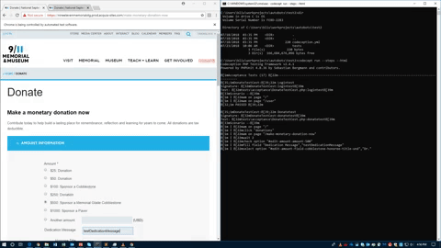
Project Abstract: To ensure the functionality and user acceptability of critical web pages and use cases using fully automated testing suites

Slide 3
What is Test Automation?

Slide 4
Why Test Automation

Slide 5
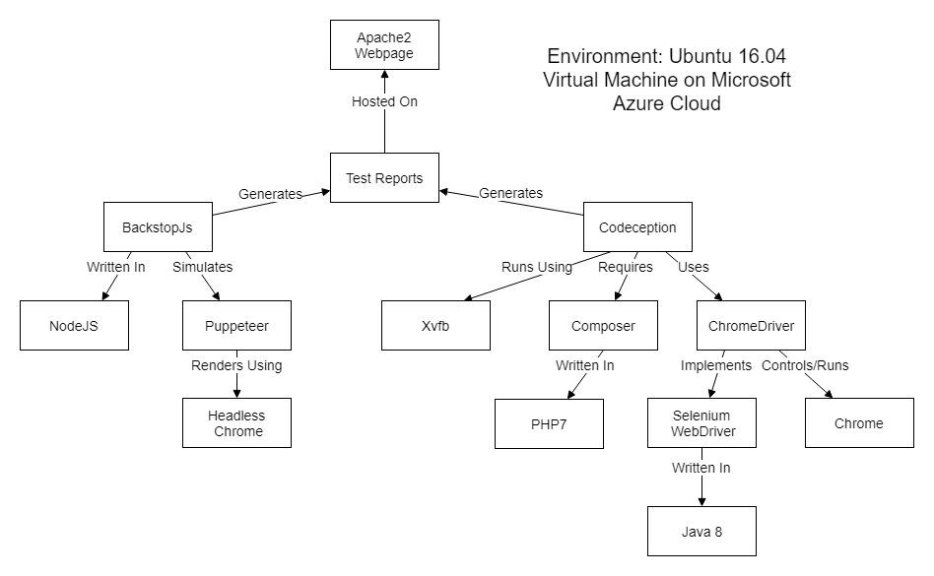
2 Approaches: User Acceptance Tests and Visual Regression Tests

Slide 6
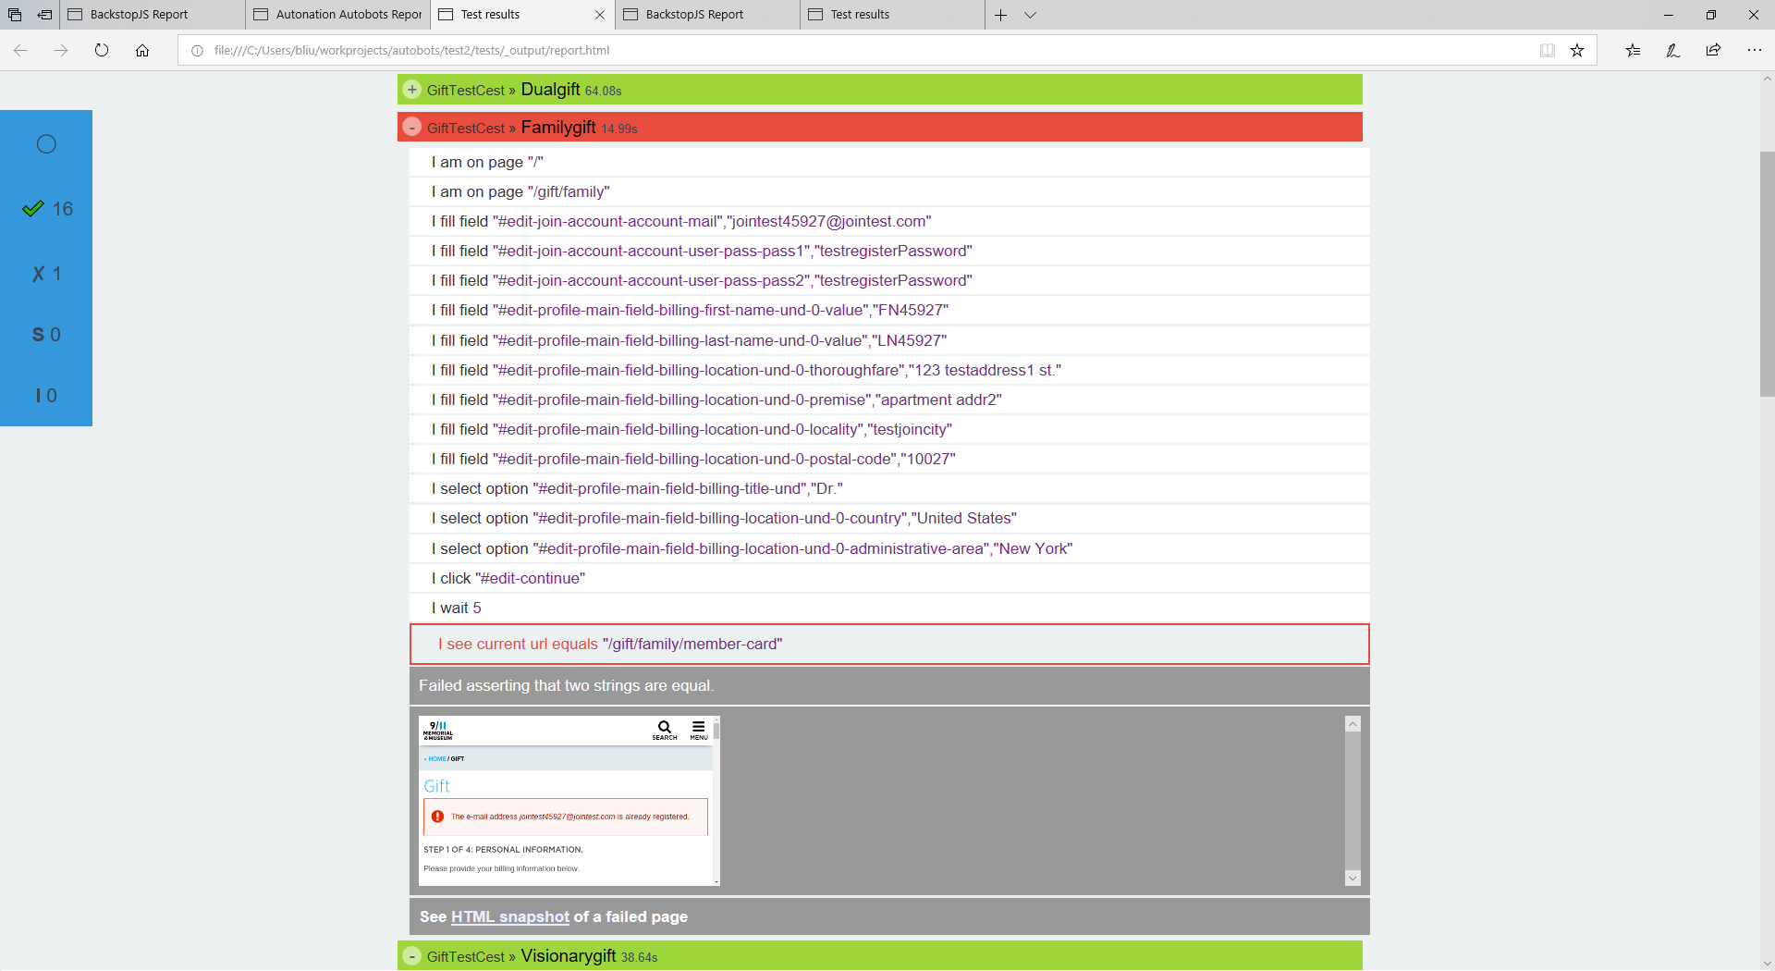
User Acceptance Tests With Codeception

Slide 7
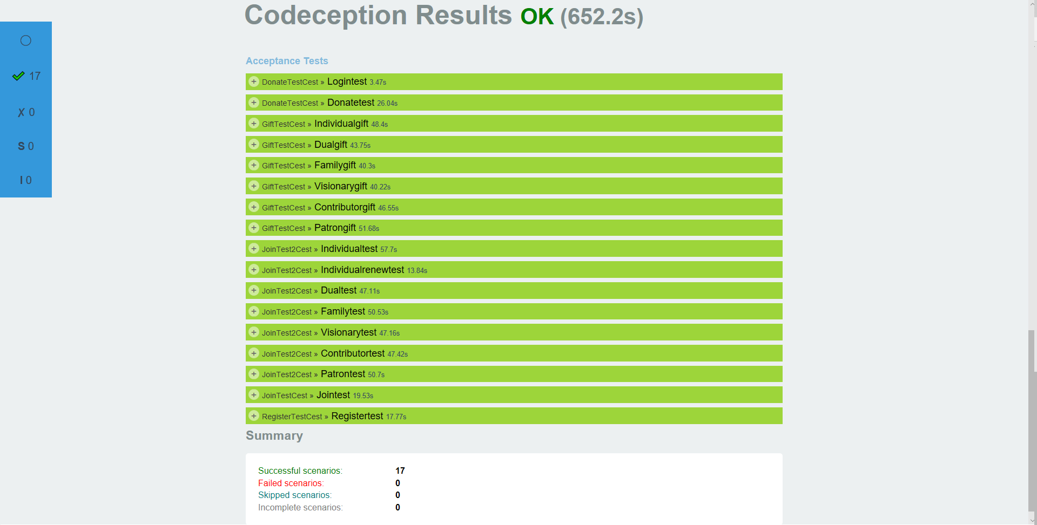
User Acceptance Tests With Codeception (Cont)

Slide 8
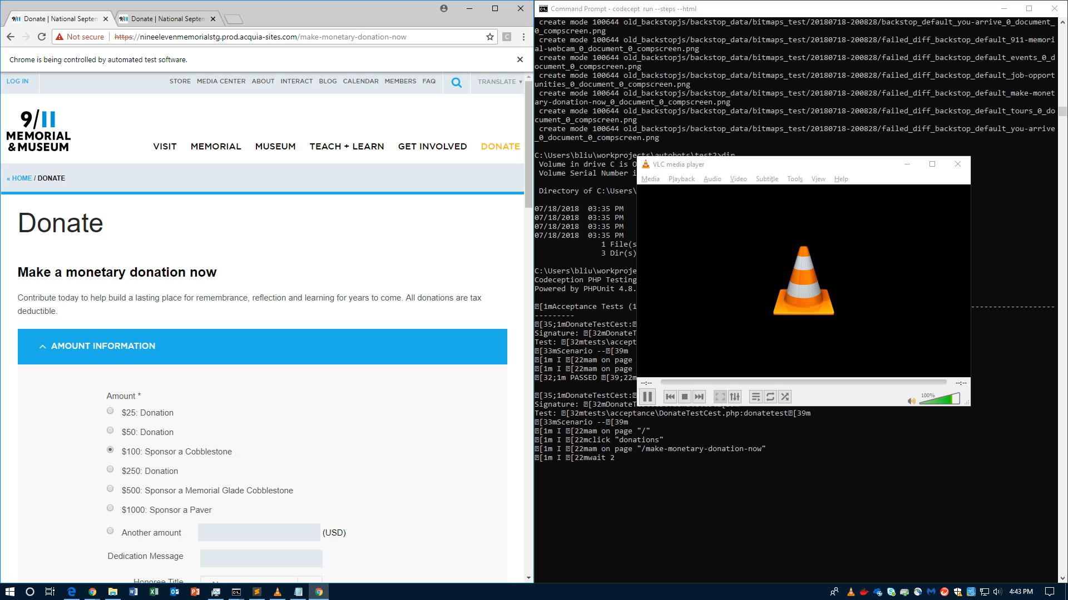
User Acceptance Tests With Codeception (Cont)

Slide 9
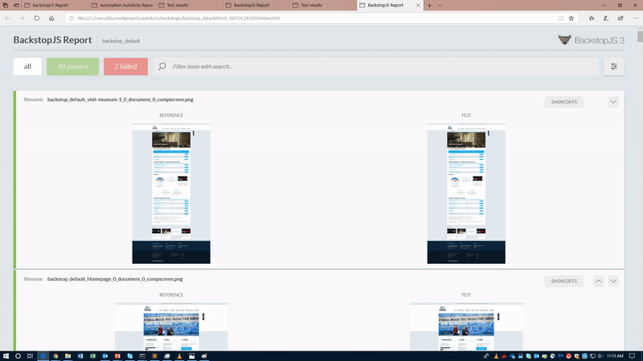
Visual Regression Tests with BackstopJS

Slide 10
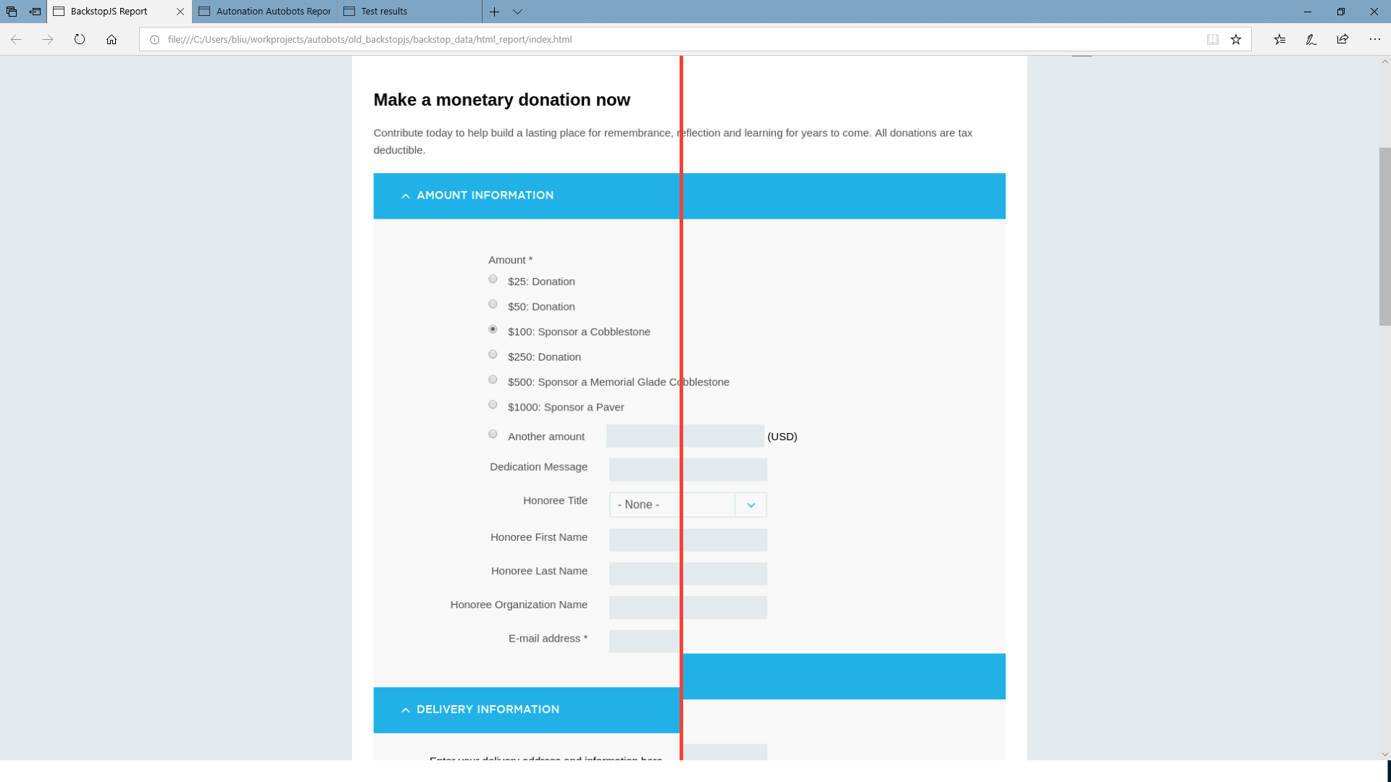
Visual Regression Tests with BackstopJS (Cont)

Slide 11
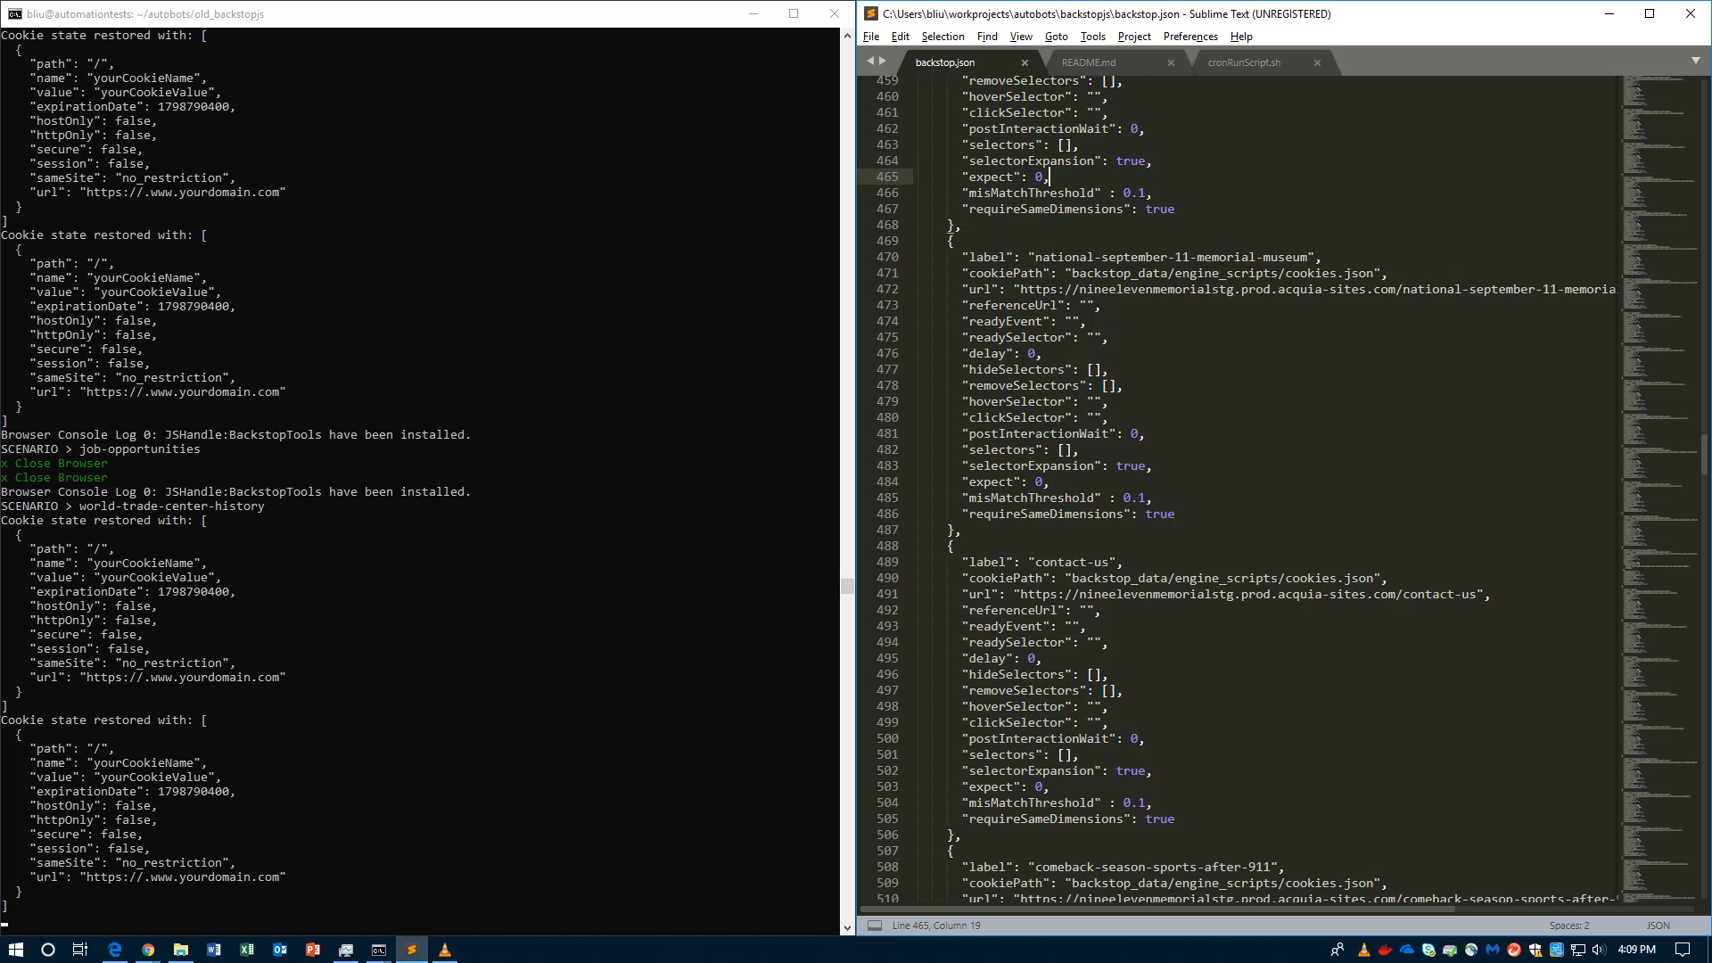
Visual Regression Tests with BackstopJS

Slide 12
Apache2 Webpage
Site Still Under Construction~~~

Slide 13
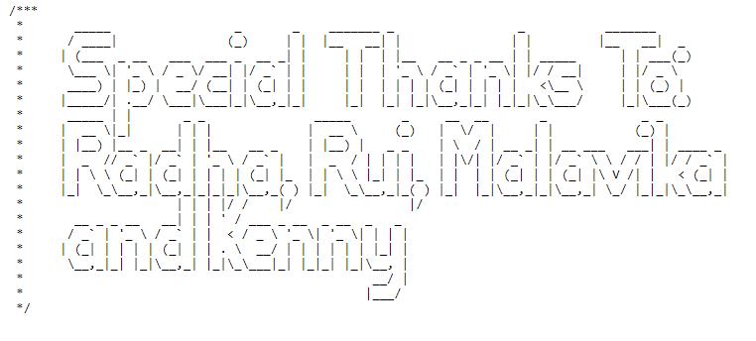
Thank You!

